Slide 1
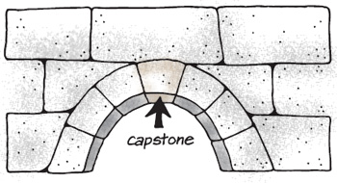

Working on your Capstone project or Thesis Paper
MLN Degree Bay Path University
Presented by Dr. Joshua Weiss

Slide 2

You have a choice
Capstone project
Thesis paper

Slide 3

What is a Capstone?
A Capstone:
A practical project in your workplace or other realm that you operate in
An opportunity to explore a problem or issue of particular personal or professional interest
Should demonstrate your ability to synthesize and apply what you have learned in the program to real-world issues and problems
Should exhibit your ability to think critically, to solve practical problems, and to communicate effectively

Slide 4
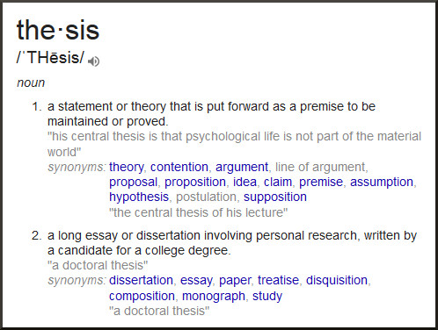

What is a Thesis Paper?
You would choose to write a thesis paper if you are interested in a specific subject or topic that you want to understand more deeply

Slide 5

Capstone/Thesis requirements and timeline
Select Project Topic; Initially define project and rationale (April 15th) Few paragraphs
Concept Draft (May 15th) 2-4 pages
More in depth proposal (June 30th) 6-10 pages
Research Activities, Implementation, and Summary (Draft of project – final paper for MLN 650 approximately the middle of August)
Evaluation, write up and final capstone completion (MLN 670 class focus -- middle to end of October depending on schedule)

Slide 6

Examples of capstone projects
Reviewing business development at a company and how leadership and negotiation is currently integrated. What is missing and how it can be improved
Development of a leadership training program at your workplace
How experiential learning leadership and negotiation activities can be integrated into our workplace courses
Adoption of badges to exhibit proficiency in leadership and negotiation

Slide 7
Examples of Thesis Papers topics in the form of a Thesis Statement
“Americans should eliminate the regular consumption of fast food because the fast food diet leads to preventable and expensive health issues, such as diabetes, obesity, and heart disease.”
“Homeless people in Berkeley should be given access to services, such as regular food donations, public restrooms, and camping facilities, because it would improve life for all inhabitants of the city.”
“Secondhand smoke is just as harmful as smoking and leads to a higher prevalence of cancer and heart disease. What’s worse, people who inhale secondhand smoke are doing so without consent. For this reason, smoking in any public place should be banned.”
Taken from: https://www.kibin.com/essay-writing-blog/thesis-statement-examples/ For more information please refer to this website

